Slide 1

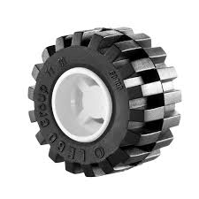
PLANNER
SCORER
WHEEL CONVERTER

